Slide 1

Chapter 4: Attention and Consciousness

Slide 2
Attention Is…
The concentration of mental energy that must be used to process incoming information
Selective
Limited
Both conscious and preconscious

Slide 3
Main points
Preconscious: Items that lie outside our conscious awareness
Priming, Automatic vs. control process
Conscious attention
1) Searching – Treisman’s theory
2) Selective Attention – Three theories, Resource account, Stroop
3) Divided Attention – Dual task paradigm
Notes:
Introduction to issues in Preconscious attention.

Slide 4
Priming
BREAD
BUTTER
How quickly do you process the second word?
Faster if you have been primed with a related word.
NURSE
CAT
DOCTOR
DOG

Slide 5
NURSE

Slide 6
DOCTOR

Slide 7
Marcel (1983)
Condition | Subliminally Present Prime | Consciously Present Prime
Prime | PALM | PALM
Mask | XXXX | XXXX
Target | PINE OR WRIST | PINE OR WRIST
Response | Body part or Plant? | Body Part or Plant?
Reaction time | How fast? | How fast?
Notes:
Distinguish between the two groups in Marcel’s study.
In the subliminally present prime group the word “palm” was presented so briefly that the participants were not able to process the word at a conscious level.
In the conscious present prime Group, participants were aware they had seen the word “Palm” before being asked about the question (Body part or Plant? ) about the target word (“Pine”).

Slide 8
Marcel (1983) Results
Condition | Subliminally Present Prime | Consciously Present Prime
Targets: PINE or WRIST | Found faster RT for both target words | Found faster RT for one of two target words, slower RT for the other target
Interpretation | Both meanings were primed | Only one meaning is primed, the other inhibited
Notes:
Discuss importance of findings for preconscious processing.
If the participant was consciously aware of seeing the word “PALM” , only one mental pathway was activated: the other pathway was inhibited.

Slide 9
Priming Can Speed or Slow Processing
Facilitative Priming
Target stimuli (e.g., BUTTER) are processed faster if preceded by a related word (e.g., BREAD)
Priming => Let us know what’s going on early cognitive processes. Information processing in unconscious level

Slide 10
Controlled vs. Automatic Processing
Automatic processing
Requires no conscious control
Controlled processing
Requires conscious control

Slide 11
Is Typing Automatic or Controlled for You?
Do you type without thinking where your fingers are? Are you a search-and-peck typer?
If you do type without using attention, what happens when you think about the letters as you are typing them?
Notes:
Discuss how skills begin as controlled and may become automatic over time.
Discuss how when you are more likely to make an error when you think about an automatic process.
Have you ever tried to teach someone how to do something you know very well, but have difficulty breaking it down into steps because you do it so automatically?

Slide 12
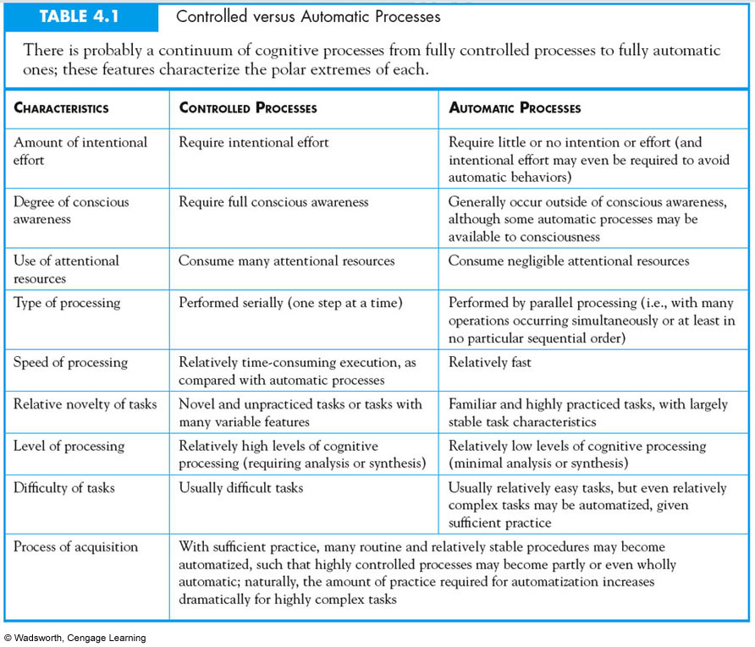

Slide 13
Functions of Conscious Attention
Searching
Selective Attention
Divided Attention
Notes:
Outline for conscious attention topics.

Slide 14
Search
Actively searching for a target
Number of targets and distracters influence accuracy
Feature search versus conjunctive search
Notes:
Define basics of searching. Explain the difference between conjunctive search versus feature search, the following slides will provide a demonstration.
Feature search: environment is scanned for one particular feature.
Conjunction Search: A combination of features is scanned for.

Slide 15
Conjunctive vs. Feature Search
Which box is it easier to detect a letter that is different?
ㅡ> a feature search
ㅡ> a conjunction search
L | L | L | L | L | L | L
L | L | L | L | L | L | L
L | O | L | L | L | L | L
L | L | L | L | L | L | L
L | L | L | L | L | L | L
L | L | L | L | L | L | L
L | L | L | L | T | L | L
L | L | L | L | L | L | L

Slide 16
Treisman’s Feature-Integration Theory
Individual Feature processing is done in parallel. Simultaneous processing is done on the whole display and if feature is present-- we detect it.
Conjunctive searching requires attention to the integration or combination of the features. Attention to particular combination of features must be done sequentially to detect presence of a certain combination.
Notes:
Explain parallel processing means all at once. Describe how sequential processing is different.

Slide 17
Another Feature Search
Is there a red T in the Display?
T
T
T
T
T
T
T
T
Target is defined by a
single feature
According to feature
integration theory the
Target should “pop out”
No attention required
T
T
T
T
T
T
T
T
T

Slide 18
Another Conjunction Search
Is there a red T in the Display?
X
T
X
Target is defined by two
Features: shape and color
According to FIT, the features must be combined and so attention is required
Need to examine one by one
T
X
T
T
X
X
T
X
X
T
T
T

Slide 19
Selectivity of Attention
Cocktail Party Problem
How are we able to follow one conversation in the presence of other conversations?

Slide 20
Cherry’s Shadowing Technique
0
Attended Ear
Unattended Ear
The doctor went to the park to find the homeless man. He was
The lawyer defended his client as the trial began. He was able
…..The doctor went to the park…..
Listen to two different conversations and repeat one of the messages, may be binaural or dichotic
Notes:
Explain difference between Binaural and Dichotic.

Slide 21
Cherry’s Study Results
0
Noticed in unattended ear:
Change in gender
Familiar name including the subject’s
Did not notice in unattended ear:
Changed language
Changed topic, same speaker
If speech was played backwards

Slide 22
Models of Selective Attention
0
Do they have a filter?
Where does the filter occur?

Slide 23
Broadbent’s Model
0
Sensory
Stores
Sensory
Filter
Working
Memory
Only one sensory channel is allowed
to proceed
Stimuli filtered at sensory level
Long
Term
Memory
Notes:
Should be equivalent to Figure 4.6 in text. Explain how Broadbent’s model explains Cherry’s data.

Slide 24
Broadbent’s Model Could Not Explain
0
Participant’s name gets through
Participants can shadow meaningful messages that switches from one ear to another
Effects of practice on detecting information in unattended ear (e.g., detect digit in unattended ear for naïve and practiced participants)

Slide 25
Treisman Attenuation Model
0
Attenuation of Unattended
Sensory
Stores
Working
Memory
Filter weakens the strength of unattended information. Arrow colors represent different levels of strength
If arrow reaches circle, info will be activated in working memory
Note some circles are closer due to different thresholds of information
Long
Term
Memory
Notes:
Should be equivalent to Figure 4.5 in text. Explain how Treisman can now account for additional findings.
Yellow arrow indicates information is being attended and the filter makes this strong, the pumpkin colored arrow is less strong and the orange arrow is made the weakest. The message of the pumpkin colored arrow may still get through due to the lower threshold (closer to the arrow).

Slide 26
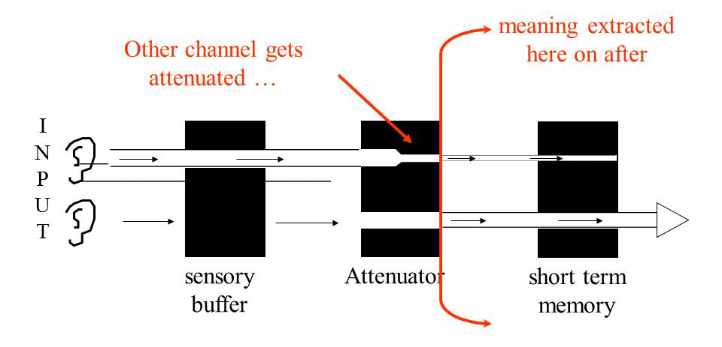
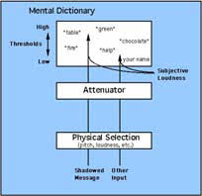

Slide 27
Late Selection Theory
0
Sensory
Stores
Working
Memory
All stimuli is processed to the level of
meaning; relevance determines further
Processing and action
Deutsch & Deutsch (1963)
Long
Term
Memory
Notes:
Pertinence = task demands and personal importance.

Slide 28
Neisser’s Synthesis
Preattentive Processes
Parallel
Note physical characteristics
Attentive Processes
Controlled processes occur serially
Occur in working memory

Slide 29
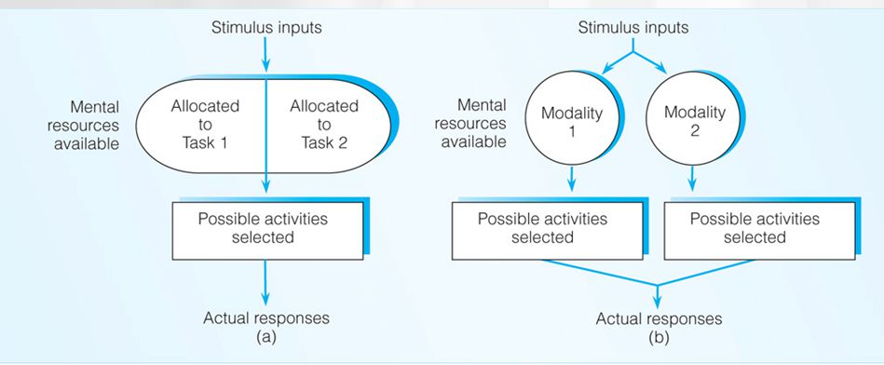
Capacity Theory of Attention
Resource is limited; Good to explain the multiple taskes; Allocating the resources -> left figure
Resources are stored by different modalities (e.g., vision, hearing); verbal reading and listening music; if the resources are allocated efficiently, they are not interfering each other

Slide 30
Stroop Effect
Say the color the words are printed in as quickly as you can
Reading interferes with your ability to state the color and your reaction time is slower
rat (control), blue(fastest)
How about bloo?
red yellow green blue red blue yellow green blue red
Notes:
Just click the mouse once and the stroop words will appear at a gradual pace.
What errors do you make? Discuss how it is interference.
What do you think would happen:
If you tried this experiment with a very small child who had not yet learned to read?
If you tried this experiment with someone who was just learning to speak English?
If you used the same order of ink colors but wrote non-color words?

Slide 31
Divided Attention
How many tasks can you do at once?
e.g. driving & talking, radio, phone...
Related to automatic processes

Slide 32
Dual Task Paradigm
0
Task 1 may require a verbal response to an auditory stimulus
Task 2 may require a participant to push a button in response to a visual stimulus.
Results indicate that responses to the Task 1 are delayed

Slide 33
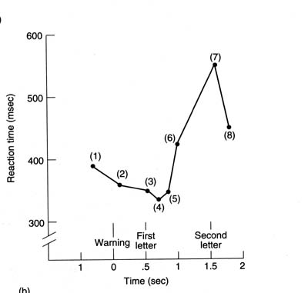
경고 신호
첫번째글자
두번째글자
1 2 3 4 5 6 7 8 :음제시

Slide 34
Real Life Dual Task
Driving and
Cell phones
Adjusting music
Watching the scenery
Almost 80 % of crashes and 65 % of near-crashes involved some form of driver inattention within three seconds of the event

Slide 35
Strayer & Drews (2007)
Naturalistic Observation of cell phone use and driver behavior
 | Failed to stop | Stopped properly
On Cell Phone | 82 | 28
No Cell Phone | 352 | 1286
Notes:
Strayer, D. L. & Drews, F. A. (In Press). Multi-tasking in the automobile. To appear in A. Kramer, D. Wiegmann, & A. Kirlik (Eds.) Applied Attention: From Theory to Practice

Slide 36
Strayer & Drews (2007) Results
Impact of hands free cell phone conversations on simulated driving:
Cell-phone conversation led to inattentional-blindness
Even if they looked at an object, participant did not remember the object

Slide 37
Attention Deficit Hyperactivity Disorder (ADHD)
0
Symptoms
Inattention
Hyperactivity
Impulsivity
Not everyone who is overly hyperactive, inattentive, or impulsive has ADHD
Behavior must be demonstrated to a degree that is inappropriate for the person's age
Notes:
National Institute of Mental Health
http://www.nimh.nih.gov/publicat/adhd.cfm Cited in text as information on ADHD.

